Slide 1
Road Accident Severity Prediction DATA606 – Project Delivery PPT
By:
Chikkala PS ManikantaVijayaSri Narasimhanaidu

Slide 2
Contents of project
Title and Author
Description And Problem Statement
Data Source
Exploratory Data Analysis (EDA)
Data Modeling, Feature Selection and Prediction
Application of the Trained Models
Conclusion
References

Slide 3
2. Description And Problem Statement
This project aims to create an application that can assess and predict the level of severity for road accidents
The project involves training a predictive model using the historical accident data.
Once the model is trained, it can be used to make predictions about the severity of accidents when given new input data, such as information about a recent accident.
This project matters because it has the potential to improve road safety, save lives, optimize resource allocation, and contribute to more effective accident prevention and response strategies.

Slide 4

Architecture Diagram
Jupyter Environment
Preprocessing and EDA
Training and
Testing
Save the Model
Model Building
Data Source
Deployment
Flask Web Application
AWS EC2
HTML
CSS
Java Script
Python
Fig 2.1: Project Architecture Diagram

Slide 5
3. Data Source
Source : Crash Reporting - Drivers Data (2015 - 2023) | Montgomery county, Maryland. (https://catalog.data.gov/dataset/crash-reporting-drivers-data)
This dataset reports details of all traffic collisions occurring on county and local roadways within Montgomery County, of the Maryland State from 2015 to September 2023.
Each row consists details about crash report.
Data Size : 79 MB
Number of columns = 43
Number of rows = 164,926

Slide 6
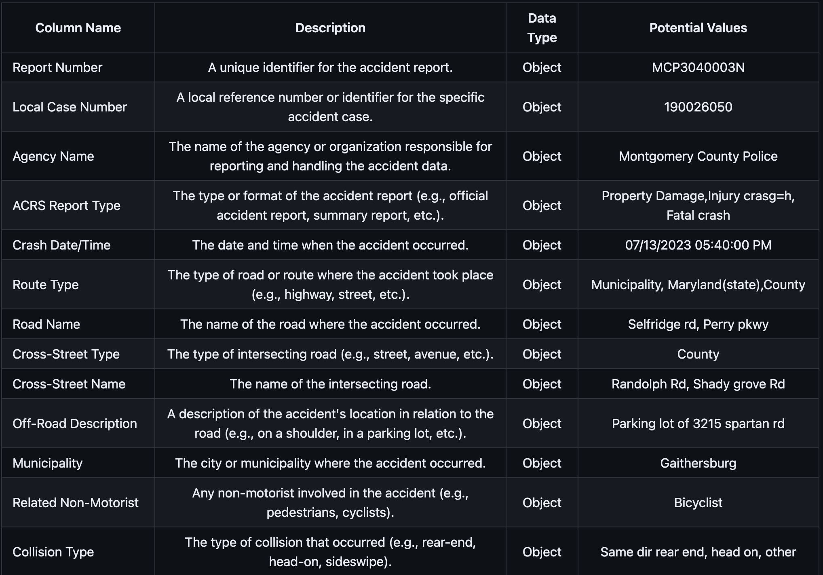
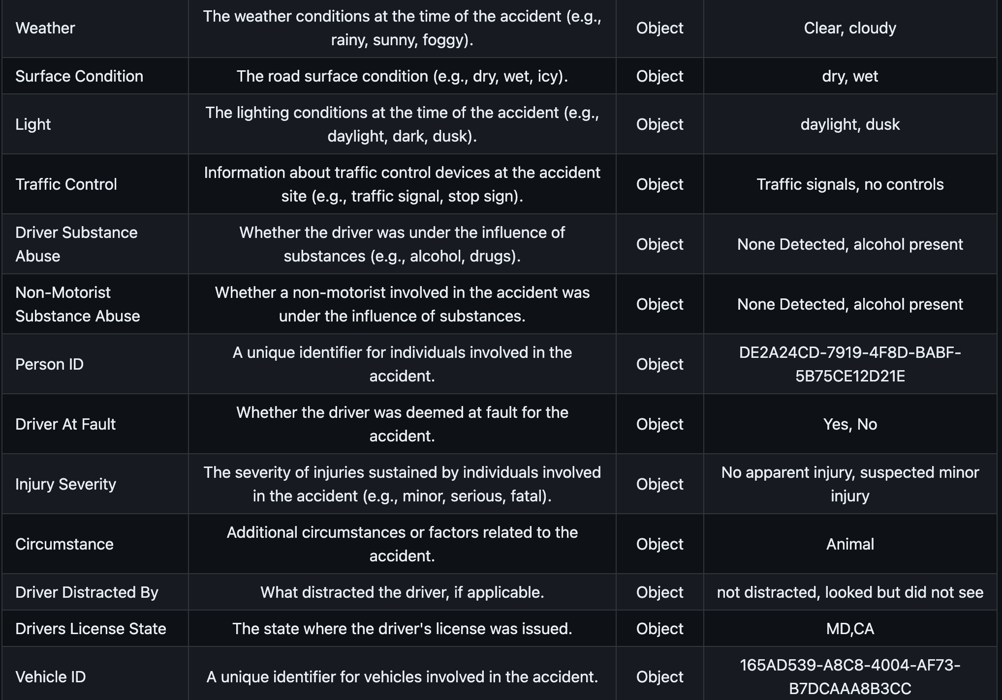
Dataset Description:
Fig 3.1: Here are examples of some of the 43 columns, along with their descriptions, data types, and potential values.

Slide 7
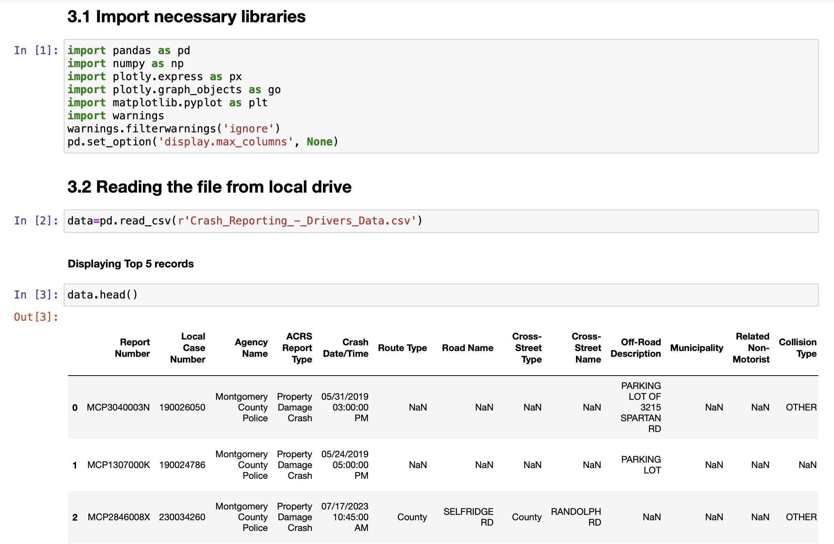
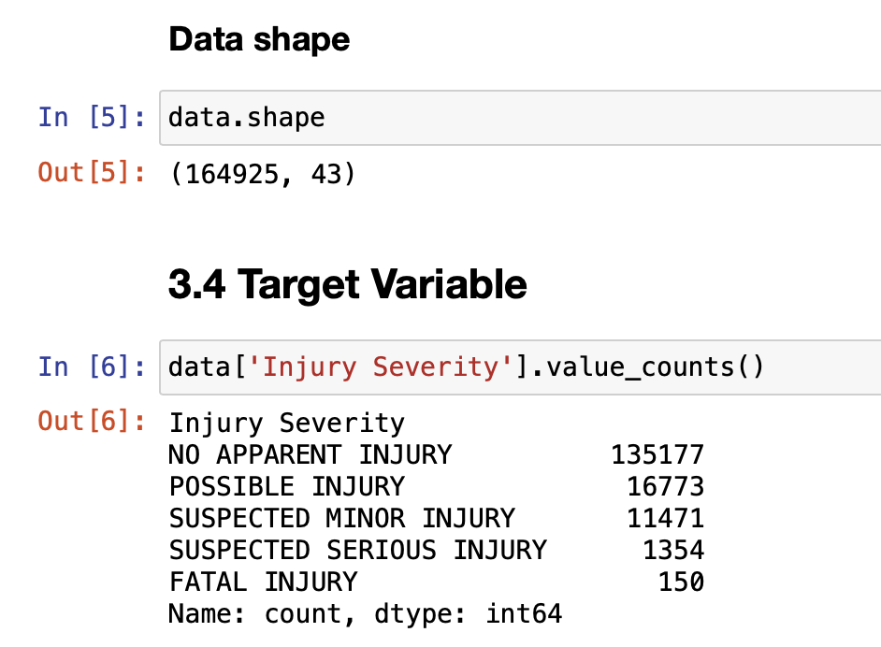
4. Exploratory Data Analysis
Fig 4.1: Importing necessary packages and reading the file
Fig 4.2: Data shape and Target Variable

Slide 8
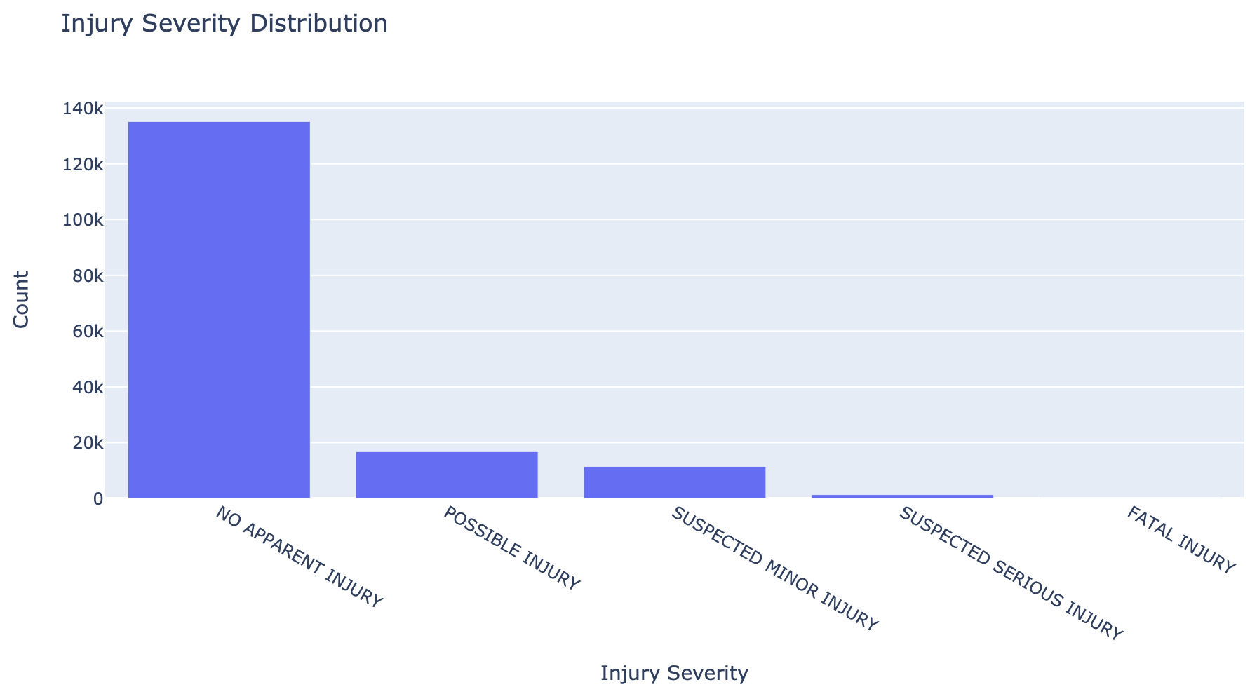
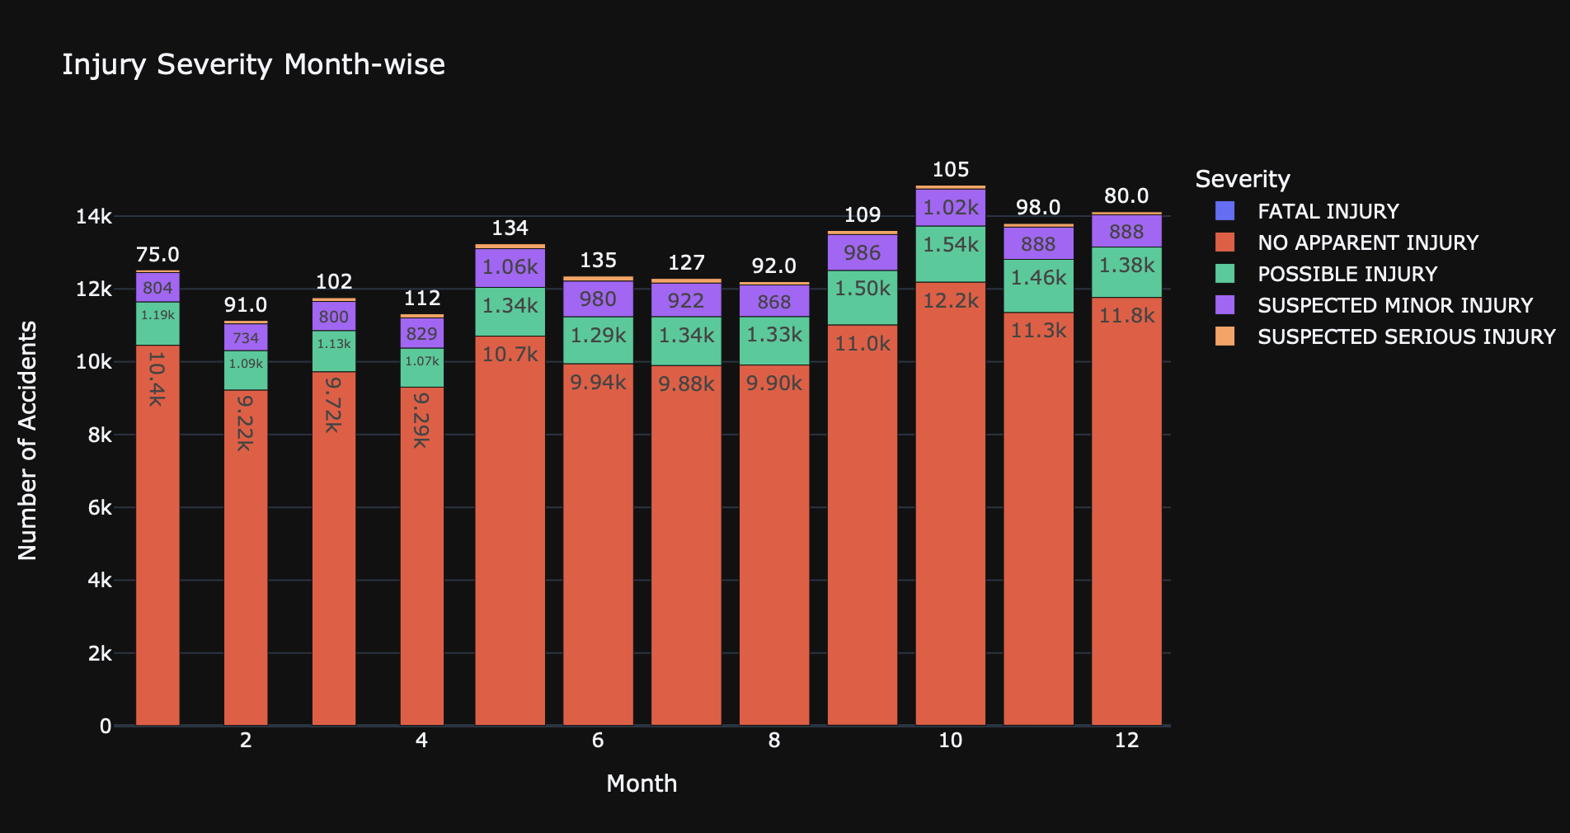
Data Visualizations
Fig 4.3: Distribution of Injuries
Fig 4.4: Distribution of Injuries month wise
Notes:
One viz per slide … keep this in separate slides

Slide 9
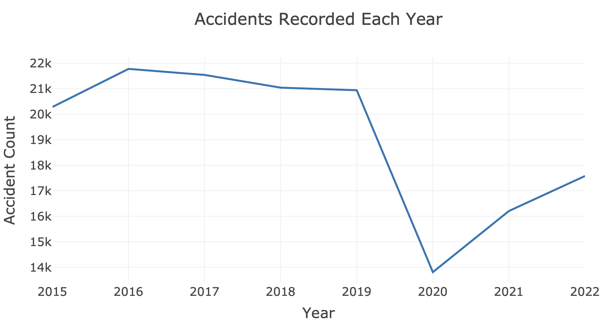
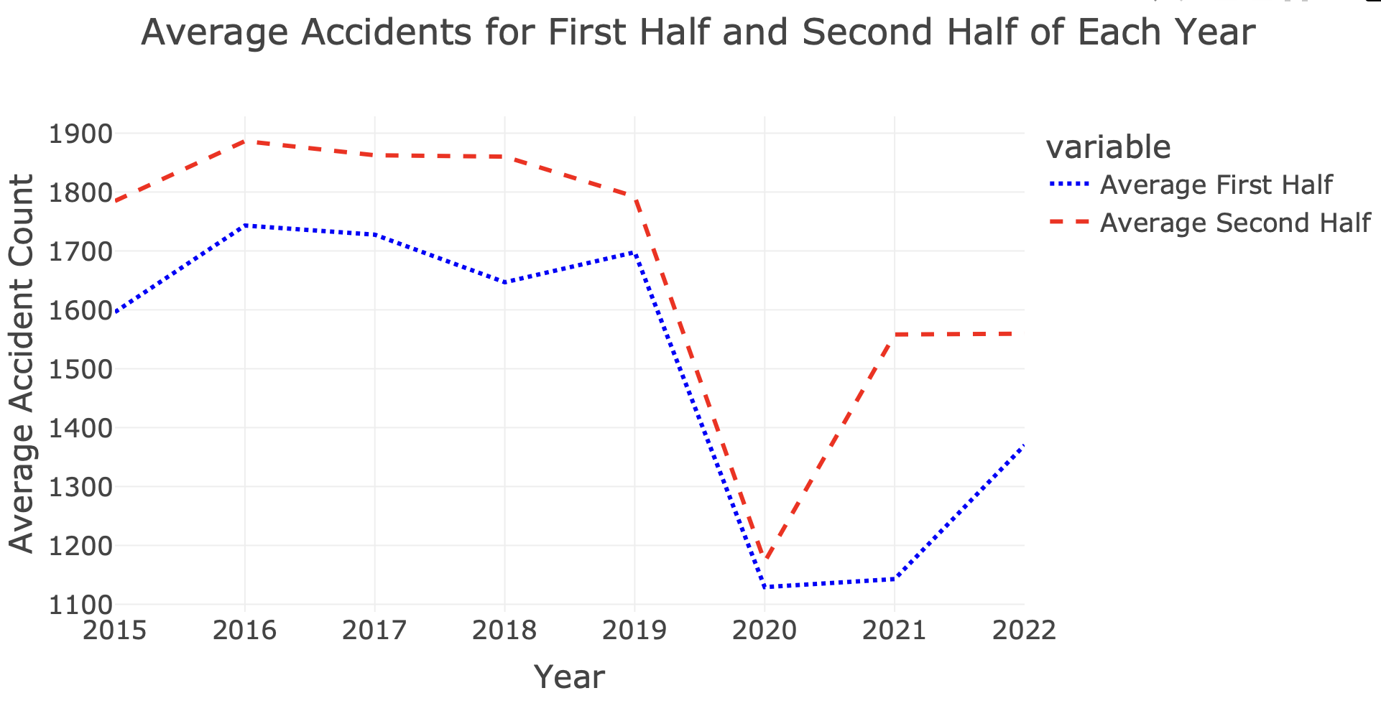
Fig 4.5:Accidents recorded in each year
Fig 4.6: Accidents During First Half and second Half of each year

Slide 10
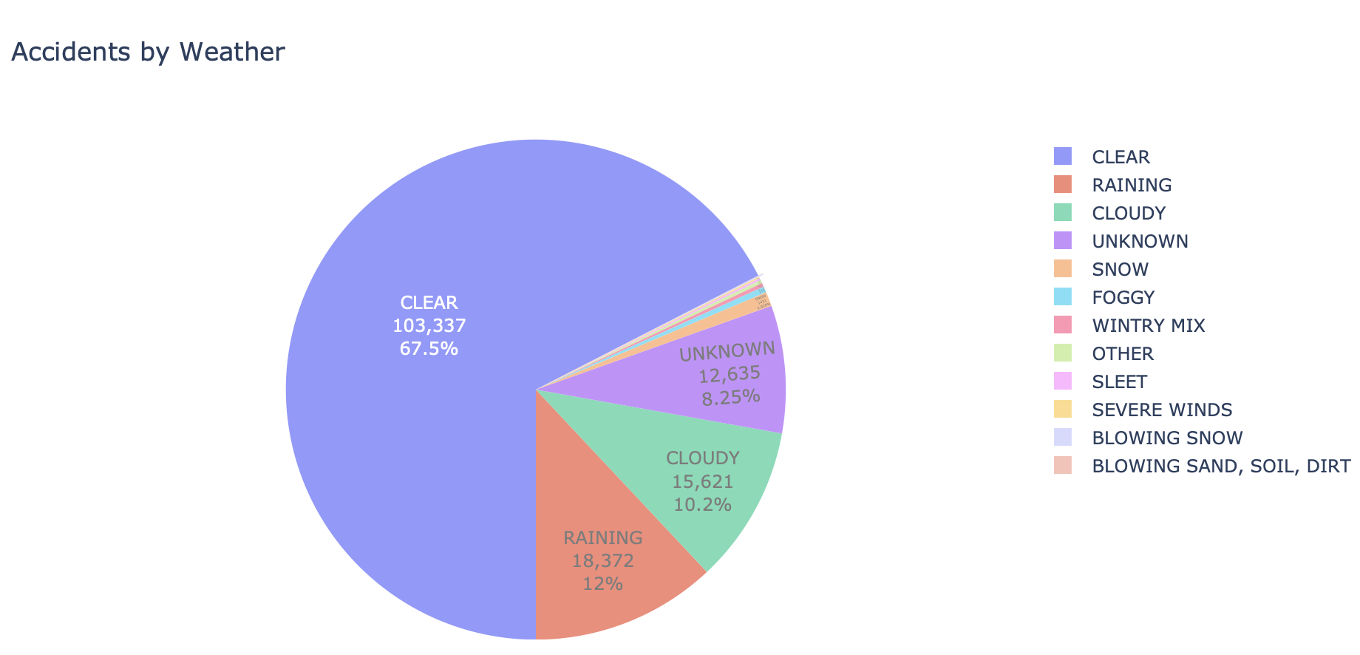
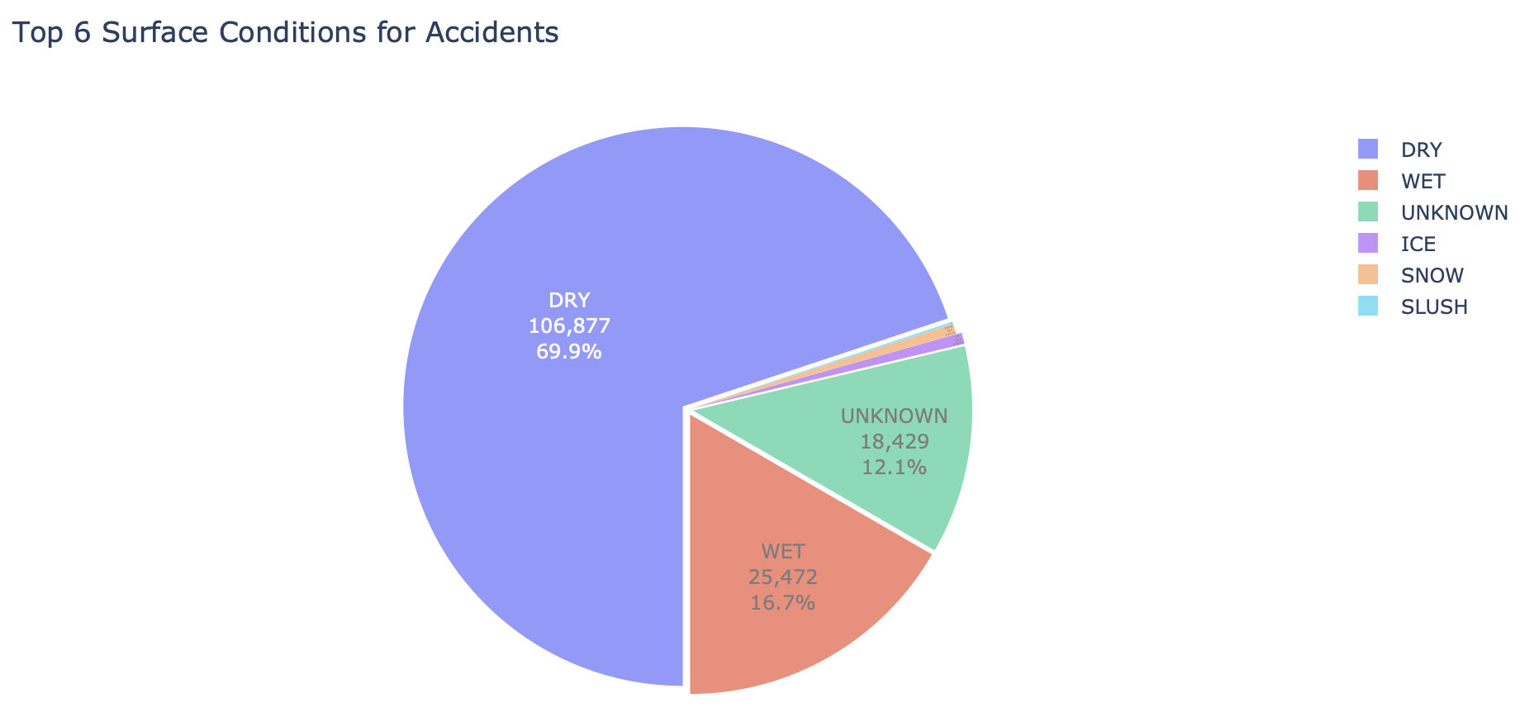
Fig 4.7: Distribution of Accidents by Weather
Fig 4.8: Accidents in Surface Conditions

Slide 11
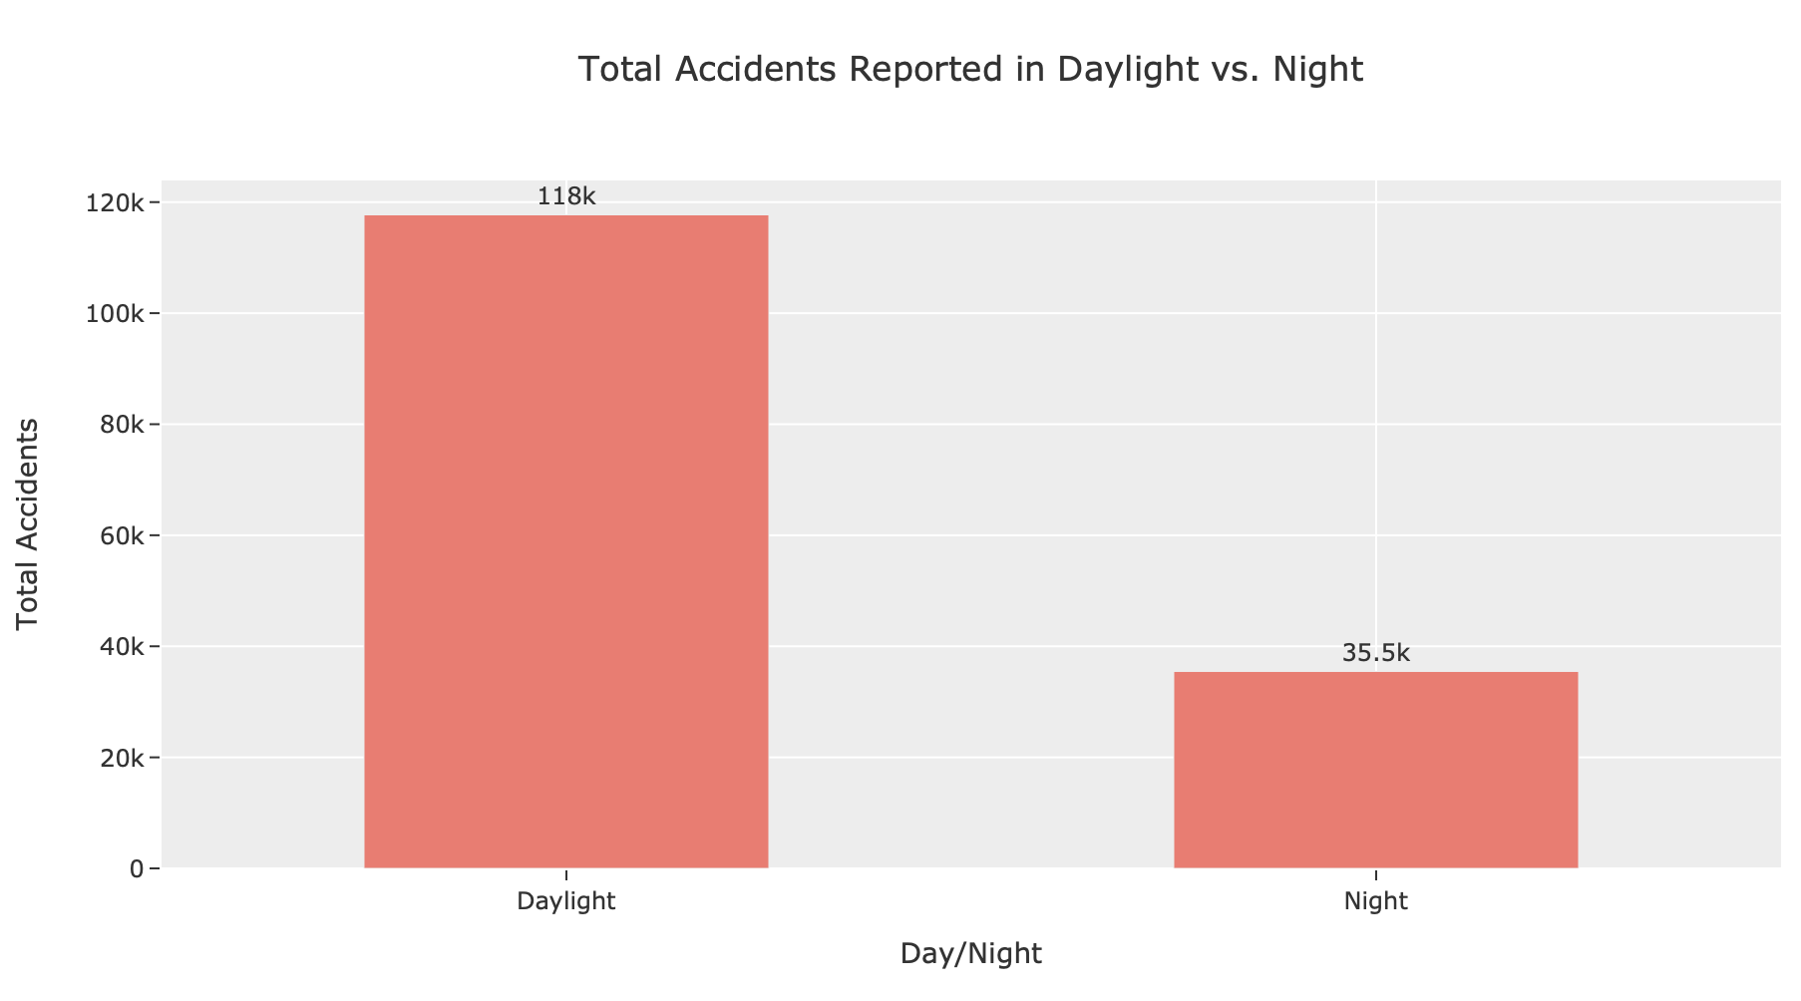
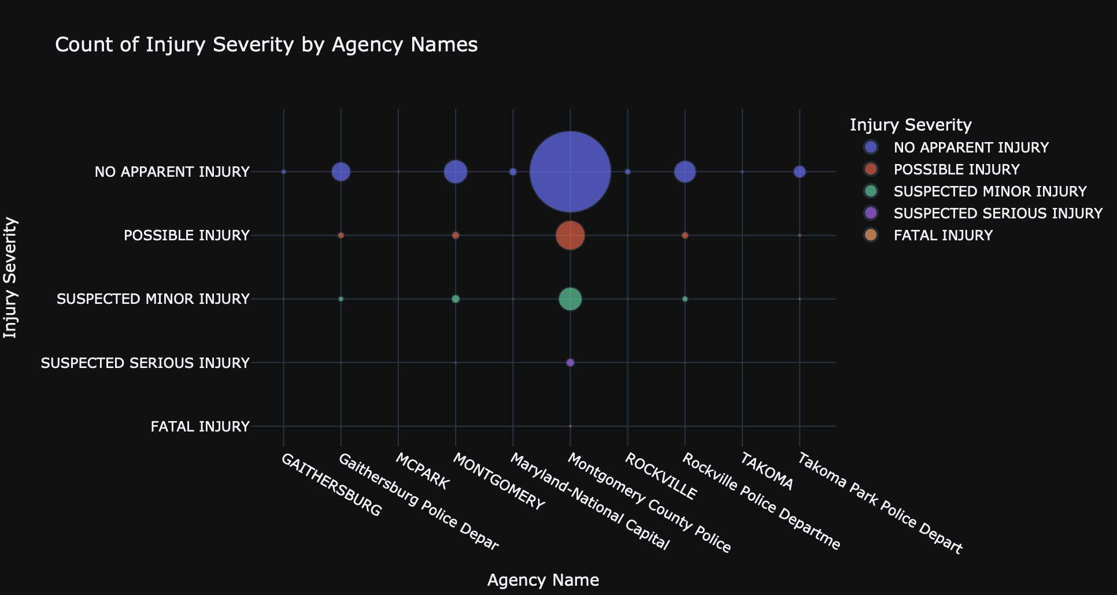
Fig 4.9: Count of Injury Severity by Agency Names
Fig 4.10: Number of Accidents in Daylight and Night

Slide 12
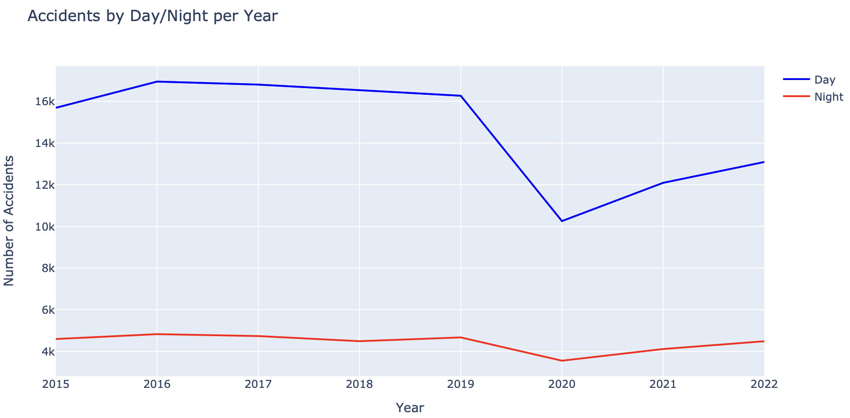
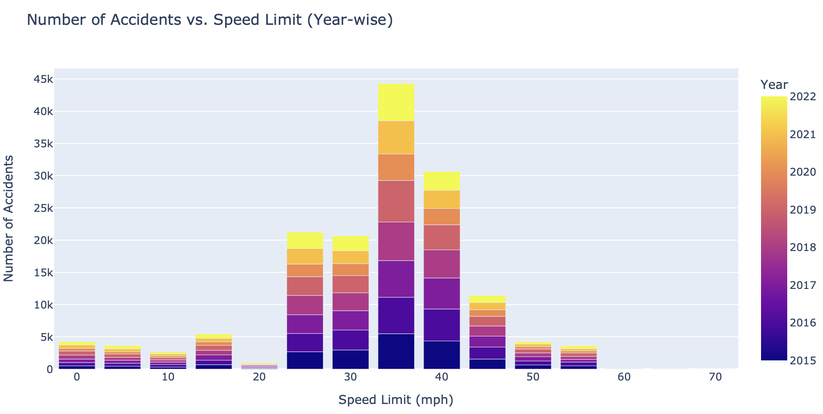
Fig 4.11: Distribution of Accidents in Daylight and Night year wise.
Fig 4.12: Number of Accidents vs Speed Limit

Slide 13
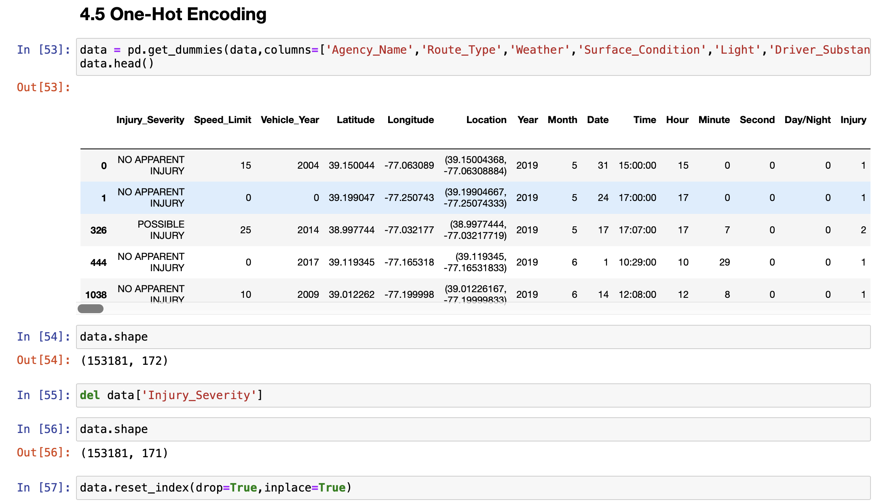
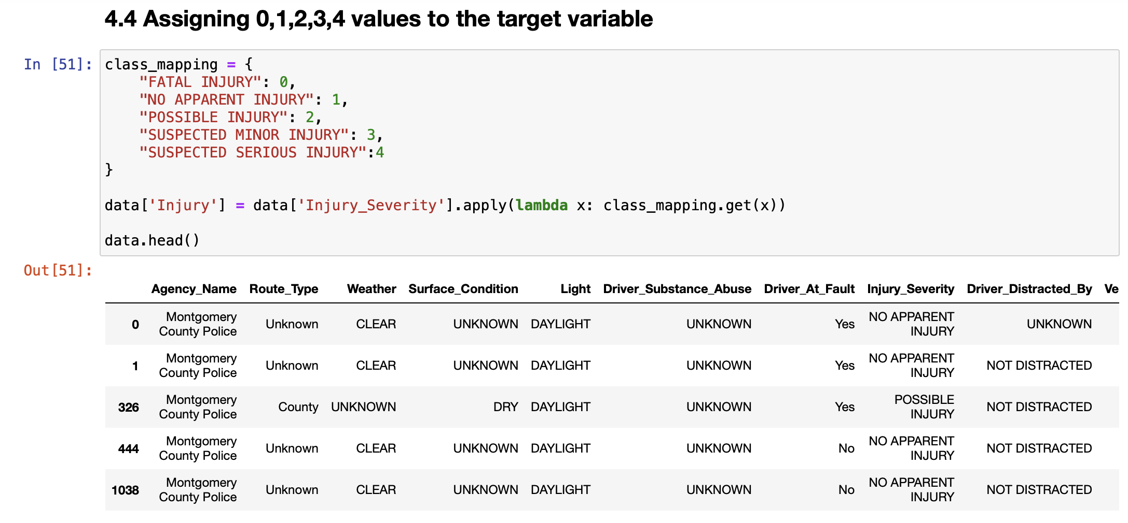
Data Cleaning and One-Hot Encoding
Fig 4.13: Assigning Numerical Values to target variables
Fig 4.14: One-Hot Encoding

Slide 14
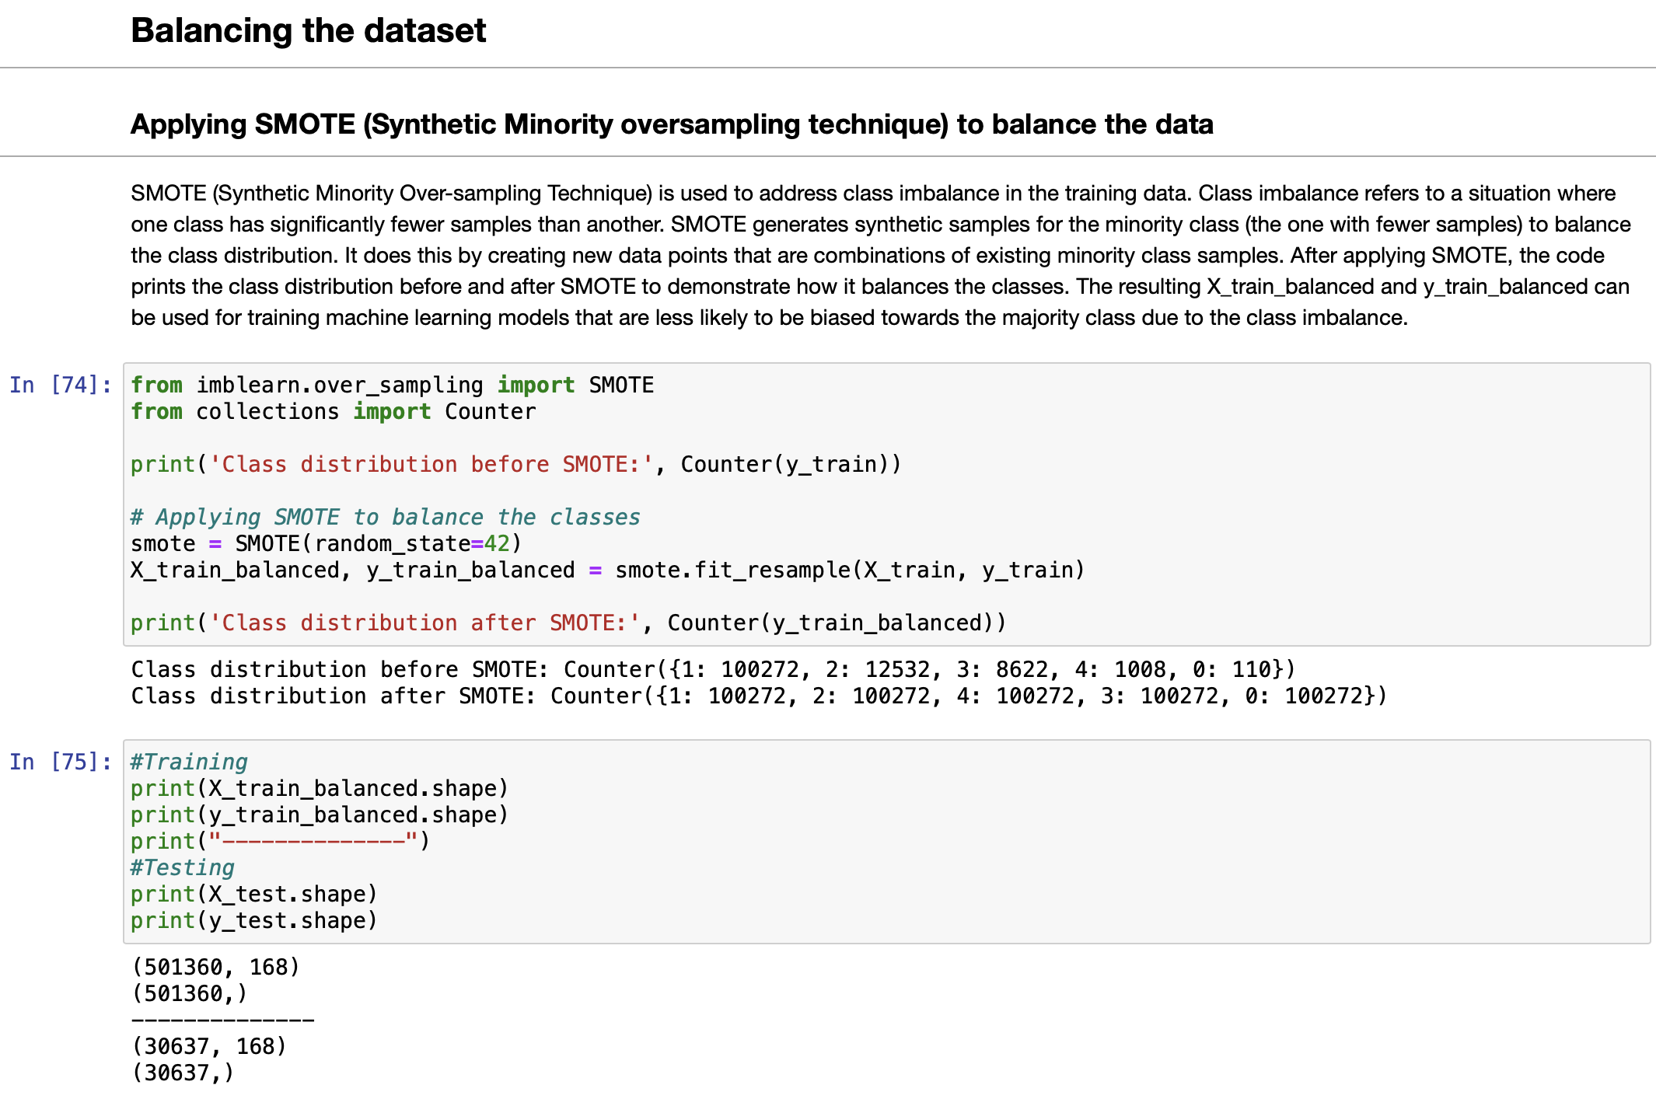
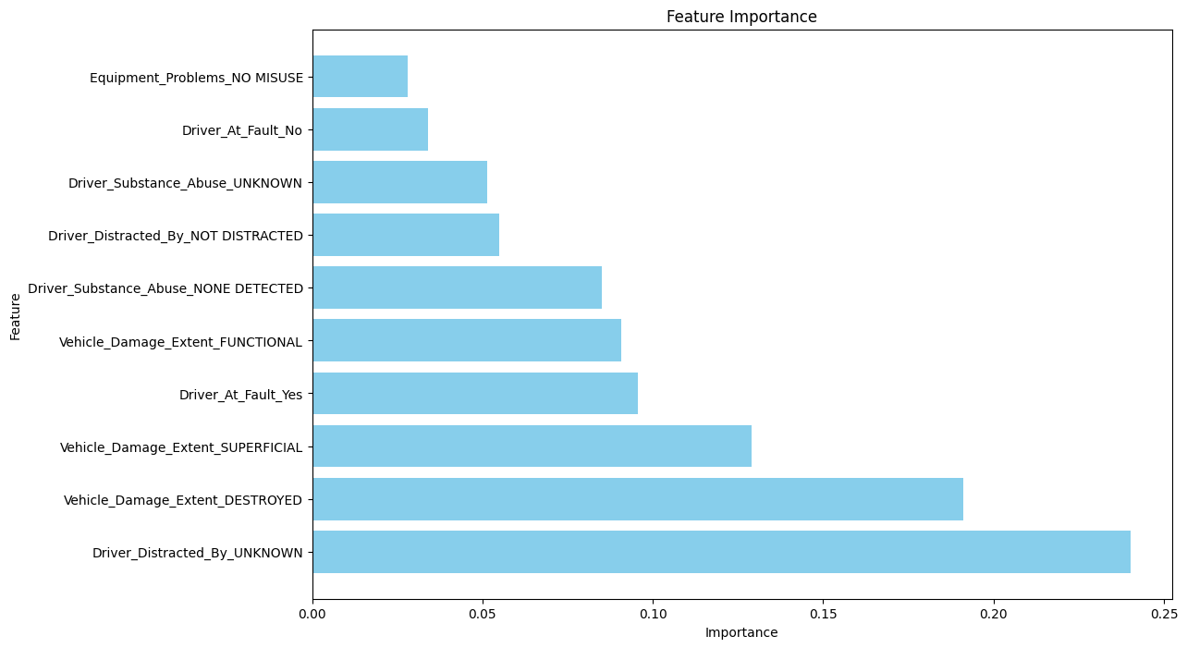
5. Data Modeling, Feature Selection and Prediction
Fig 5.1: Balancing the Dataset
Fig 5.2: Feature Importance plot from SelectKBest

Slide 15
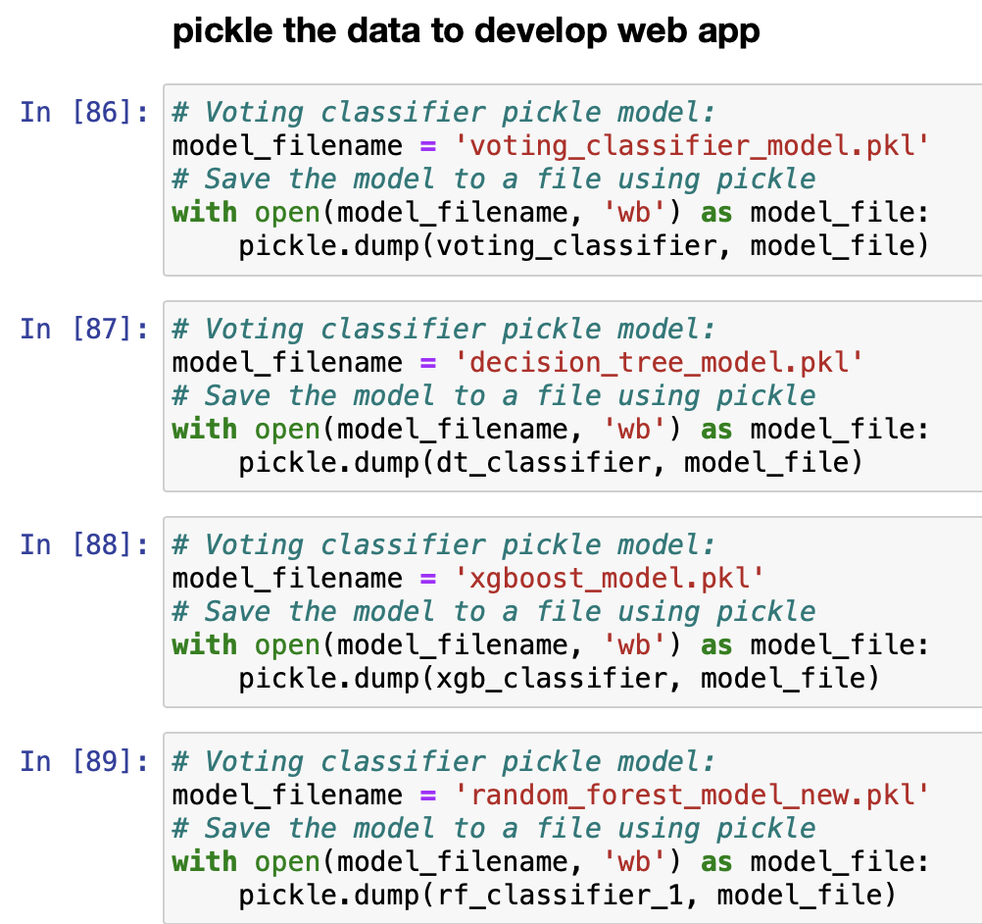
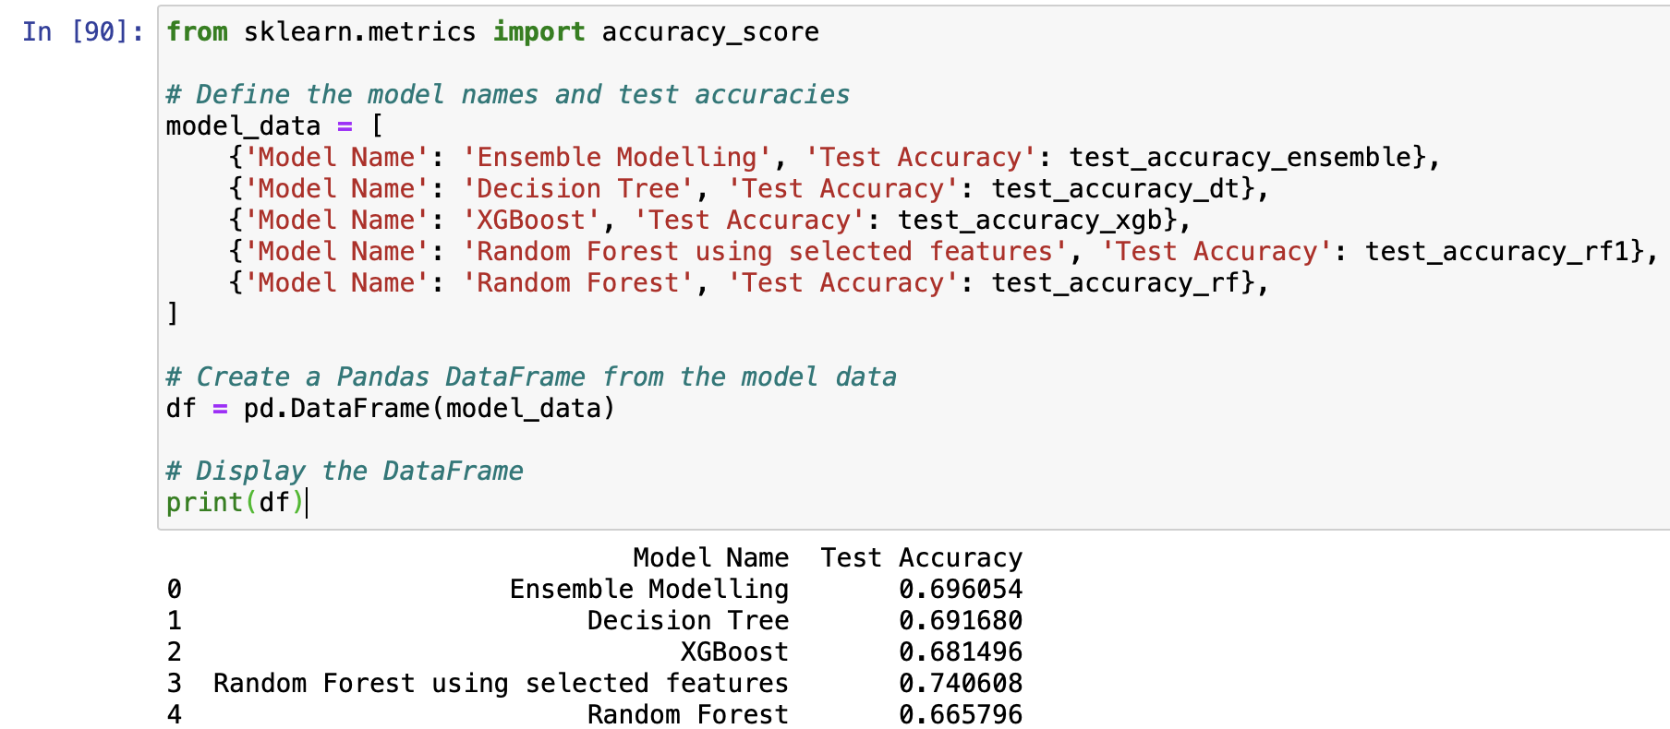
Save the Model
Fig 5.3: Models Accuracy Score
Fig 5.4: Saving the Model

Slide 16
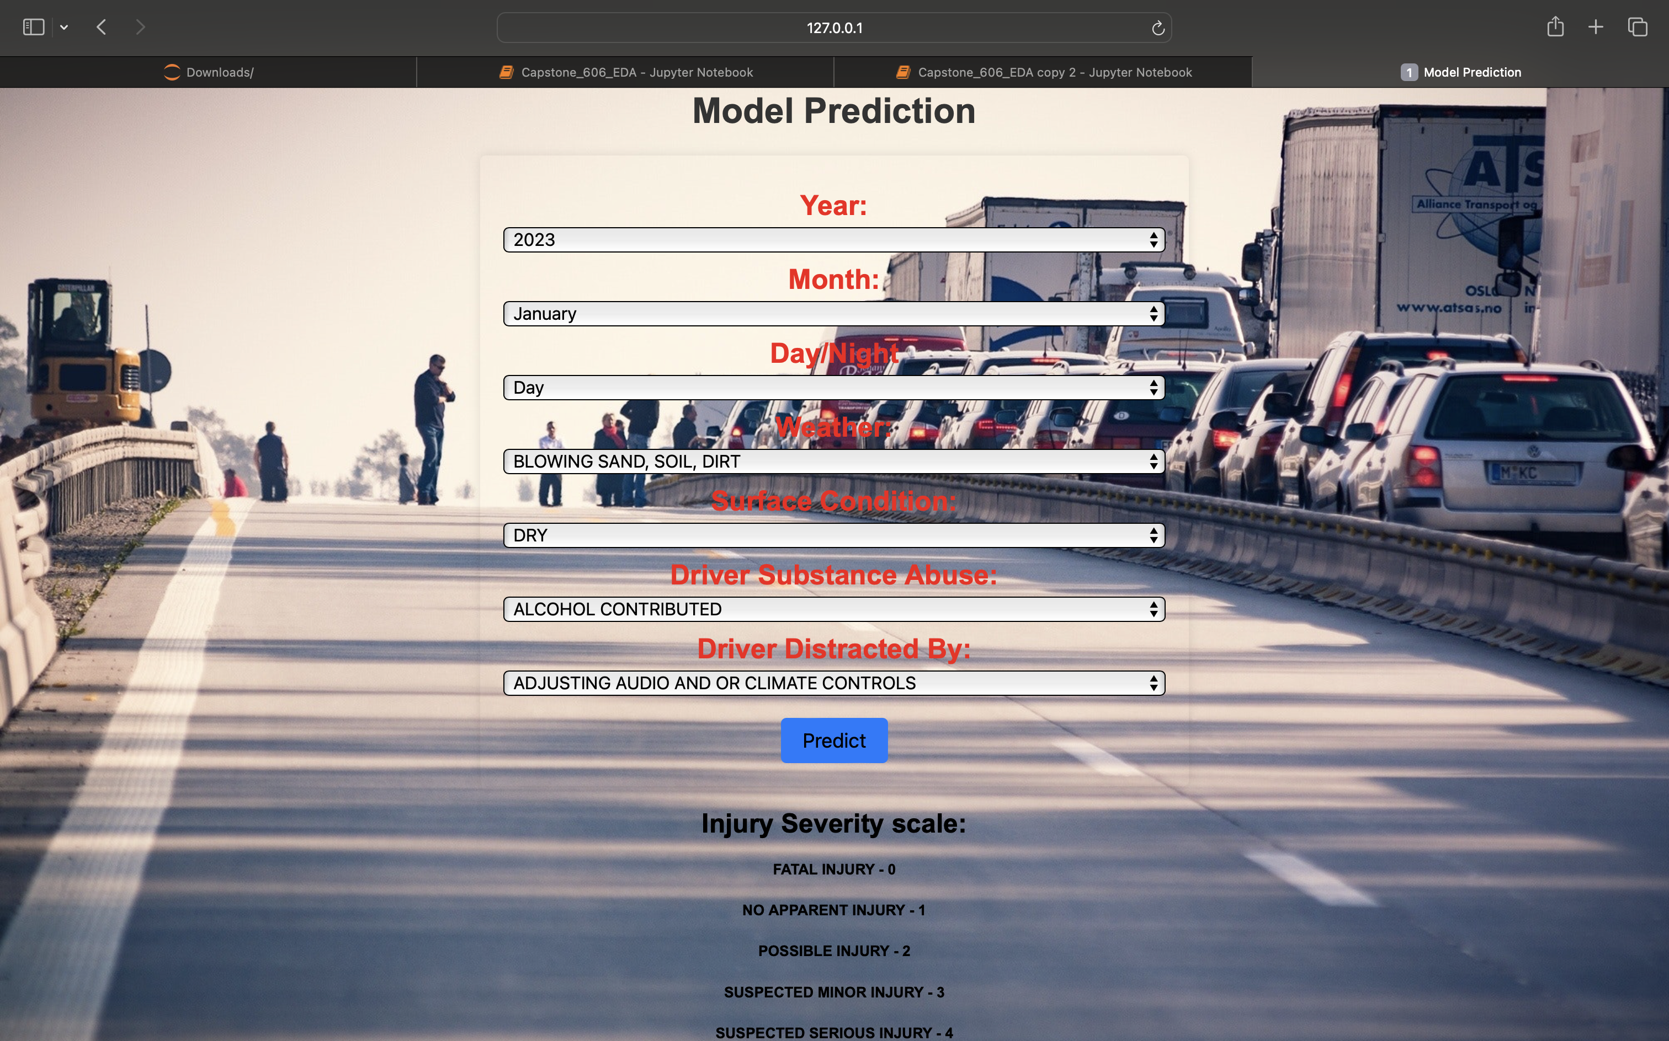
6. Web Application Using Flask
Fig 6.1: Web App

Slide 17
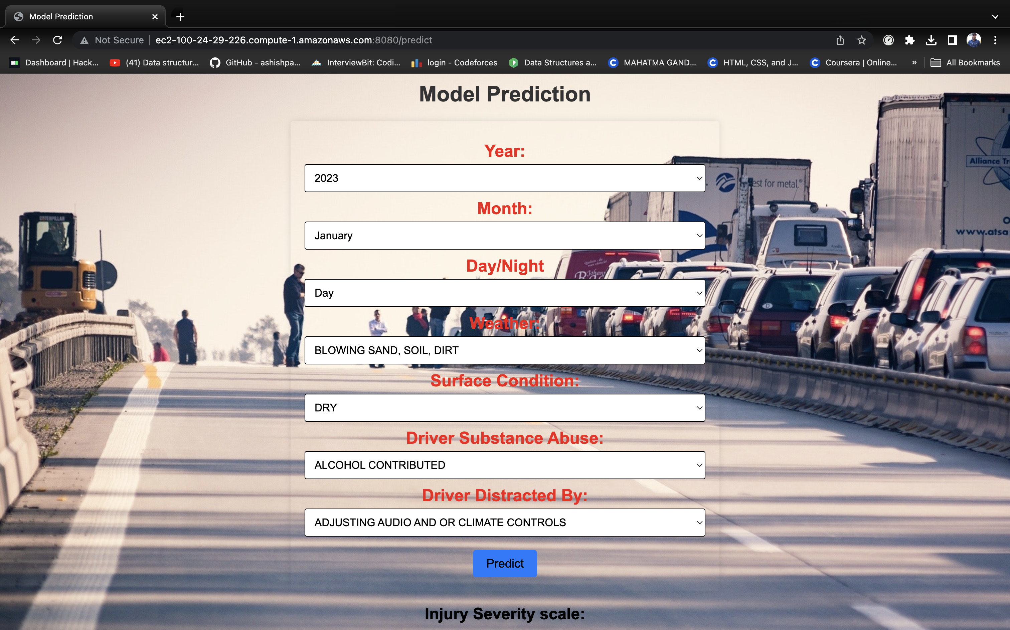
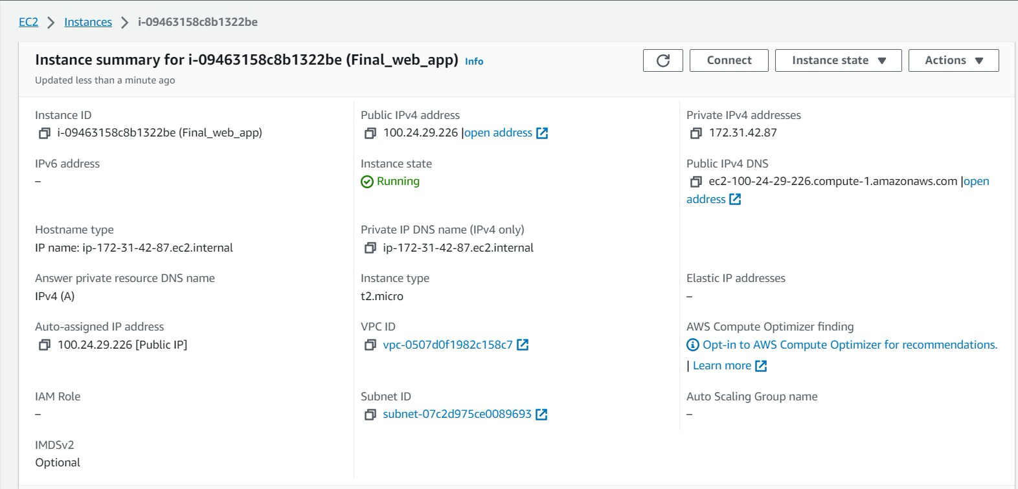

Deployment In EC2
When I run the EC2 instance you can access the model through this link:
http://ec2-100-24-29-226.compute-1.amazonaws.com:8080/
Fig 6.3: Running the EC2 instance
Fig 6.4: Deployed App Running

Slide 18
7. Conclusions
Number of accidents got decreased during the COVID period 2019-2020 and moved an upward trend after that till 2022.
Most accidents happen in the second half of the year that is during winters (sept-dec).
Most of the accidents happened in the daylight.
Most accidents happened when the weather is clear and road surface is dry.
Most of the accidents happened within the speed limits of 25-40 MPH.
Most of the accident’s prediction comes out as no apparent injury.

Slide 19
8. References
https://plotly.com/python-api-reference/
https://machinelearningmastery.com/smote-oversampling-for-imbalanced-classification/
https://scikit-learn.org/stable/modules/generated/sklearn.feature_selection.SelectKBest.html
Data Source : https://catalog.data.gov/dataset/crash-reporting-drivers-data

Slide 20
Thank you

